Slide 1
Civil Liberties and Civil Rights

Slide 2
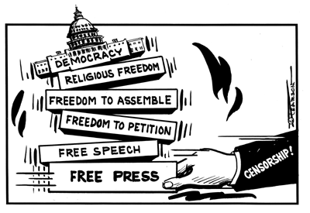
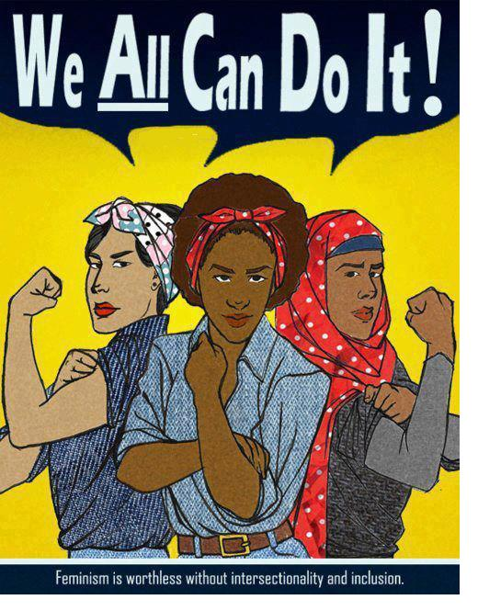
Civil Liberties vs. Civil Rights
Civil liberties
Civil rights
place limits on government
give the individual "liberty" from the actions of the government
provide “due process” of the laws
Bill of Rights
deliberate actions taken by government to create equal conditions for all
provide equal protection of groups in the minority
14th Amendment
“equal protection”

Slide 3
How do the 1st and 14th Amendments overlap?
The Bill of Rights Amendments originally applied to the national government
Through a case by case basis, the courts required the states to also follow most of the provisions of amendments 1-8
This process is called selective incorporation
A group facing discrimination due to expressing an unpopular or extreme viewpoint, or in a religious minority, is guaranteed equal protection under the 14th amendment
This has led to great conflicts regarding which groups deserve civil rights protection
Complementary
Controversial

Slide 4
What influenced establishment of American civil liberties?
The Age of Enlightenment 1650s-1780s
Challenged the authority of the Catholic Church
Idea of reforming society with toleration, science and skepticism
Idea of natural rights—all humans are born with these
life
liberty
property
Idea of the social contract—people need protections and agree to give up certain freedoms for that protection. What is the best form of protection?
absolute monarchy (Hobbes)
Constitutional monarchy or republic (Locke)
Limited government with the consent of the governed (Locke)
Democracy or whatever is decided directly by the people (Rousseau)

Slide 5
What influenced establishment of American civil liberties?
Early British documents
Magna Carta
English Bill of Rights
Petition of Right
State documents
Virginia Declaration of Rights (George Mason)
Massachusetts Body of Liberties
General mistrust of strong national government based on the former colonial relationship with Britain

Slide 6
Definitions simplified
Civil Liberties
Rights that need protection from the government having too much control
Bill of Rights
Amendments 1 through 10 of the US Constitution
Incorporation
use of the 14th amendment in case decisions to make the Bill of Rights apply to actions of the states
Civil Rights
Rights that need protection by the government supporting a specific group
Due process
a legal understanding that you are owed certain rights from the government
Equal protection
a constitutional guarantee that no person or class of persons shall be denied the same protection of the laws that is enjoyed by other persons or other classes of people

Slide 7
Episode Two:
It’s a Free Country
(0-2:13, 5:00-11:30)

Slide 8
The Bill Of Rights: 1st Amendment
First Amendment rights include:
Freedom of Expression
Freedom of speech
Freedom of the press
Freedom to assemble peaceably
Freedom to petition the government for a redress of grievances
Freedom of Religion
Establishment clause
Free exercise clause

Slide 9
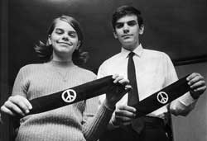
Symbolic Speech
Is this protected speech?
Can kids wear protest armbands in school, if they do not disrupt the educational process?
Yes.
Tinker v. Des Moines School District (1969)

Slide 10
Symbolic Speech
Is this protected speech?
Can you burn the flag in peaceful protest?
Yes.
Texas v. Johnson (1989)

Slide 11
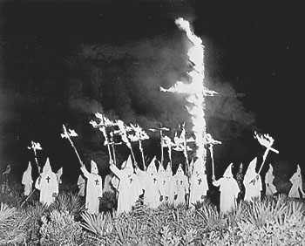
Freedom of Expression
Are these both protected speech?
Yes.

Slide 12
Freedom of Expression
When is speech NOT protected?
Schenck v. United States (1919) – not if it demonstrates a “clear and present danger”
Gitlow v. New York (1925) – not if it “advocated the violent overthrow of the government”
Brandenburg v. Ohio (1969) – not if the speaker caused “incitement to imminent lawlessness”
“fighting words”--words which would likely make the person to whom they are addressed commit an act of violence (intended to cause the hearer to react toward the speaker)

Slide 13
Freedom of Expression
When is speech NOT protected?
Obscenity
A legal definition
Pornography ≠ obscenity
Miller v. California (1973)
Average person finds it violates
contemporary community standards
Work taken as a whole appeals to a prurient interest in sex
Work depicts patently offensive sexual conduct
Work lacks serious redeeming literary, artistic, political, or scientific value
A community-based standard
Almost all internet speech is unregulated in America because there is no “community standard” on the worldwide web
(Reno v. ACLU, 1997)

Slide 14
Freedom of Expression
Is this protected speech?
No. Morse v. Frederick (2007)

Slide 15
Freedom of the Press
Does the media have unlimited free speech?
Print media enjoys freedom from “prior restraint”
Broadcast media must obey certain restrictions enforced by the FCC

Slide 16
Freedom of the Press
When is the Press NOT protected?
Slander (spoken) and Libel (written) are not protected
Two factors define this
Knowingly publish with reckless disregard as the truth statements known to be false
Intentionally injurious to person’s character or reputation (malicious intent)

Slide 17
Freedom to Peaceably Assemble
Balance right to free association with right for public order
Permissible for localities to require permits in order to protest
Can a predominantly-Jewish town withhold a permit allowing the NAZIs to hold a rally?
No. National Socialist Party of America v. Village of Skokie (1977)

Slide 18
1st Amendment: Freedom of Religion
Two clauses
Establishment Clause
Free Exercise Clause

Slide 19
Religious Freedom
Establishment Clause
Can public school funding be used to supplement private (mainly Catholic) school teachers’ salaries?
No. Lemon v. Kurtzman (1971)
Aid must be secular in intent
Its primary effect can neither enhance nor inhibit religion
Government must avoid “excessive entanglement” with religion

Slide 20
Religious Freedom
Does the government assist religious schools with tax dollars today?
Yes.
Courts have ruled that it is ok for tax dollars to be spent on: school lunch, transportation, speech/hearing support, standardized tests, computer purchases and internet access, vouchers; subject to Lemon test restrictions

Slide 21
Religious Freedom
Is School Prayer protected?
Mandatory?
Daily bible readings?
Moment of silent prayer?
Moment of silence for non-religious reasons?
No. Engel v. Vitale (1962)
No. Abington School District v. Schempp (1963)
No. Wallace v. Jaffree (1985)
Yes. Brown v. Gwinnett County S.D. (1997)

Slide 22
Religious Freedom
Permissible to have school functions (like graduation) in a church, with religious icons on display?
No. Elmbrook School District v. John Doe (2015)

Slide 23
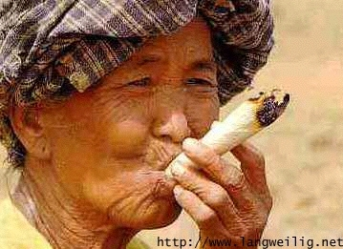
Religious Freedom
Free Exercise
Distinction between belief and practice
Courts have upheld state intervention in religious practices
Drug Use permissible?
No. Oregon v. Smith (1990) state unemployment
benefits were denied even though peyote was
used as a religious ritual
Yes. Gonzales v O Centro Espirita Benficiente Unaio do Vegetal (2006) hallucinatory tea was acceptable as part of a religious ceremony

Slide 24
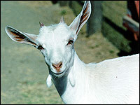
Religious Freedom
Free Exercise
Is animal sacrifice permissible?
Yes.
Church of the Lukumi Babalu Aye (Santeria) v. City of Hialeah (1993)

Slide 25
Other Amendments in the Bill of Rights
2nd: right to bear arms
3rd: no quartering during peacetime
4th: no unreasonable search and seizure
5th:
right against self-incrimination (“I plead the fifth”)
right to grand jury
no double jeopardy
cannot be deprived of life, liberty or property without due process of law
eminent domain/just compensation
6th:
right to counsel and a speedy, public trial with a jury
right to be informed of charges and confront witnesses against you
7th: right to a jury if you are suing for over $20
8th: no excessive bail nor cruel or unusual punishment
9th: the people retain any rights not listed in the constitution
10th: any rights not granted to the federal government reserved for states

Slide 26
Let’s try a Friendly Controversy activity
Legal Model
Your group will critically examine how a free speech decision affected government policy
Google the assigned landmark Supreme Court case
What were the arguments of this case?
Compare the majority opinion with the minority (dissenting) opinion and provide a quote from each that you felt was significant
Did the decision expand or restrict civil liberties? How?
Only one person from the group needs to present.

Slide 27
Friendly Controversy: Legal Model The Cases
Mapp v. Ohio (1961)
Engel v. Vitale (1962)
Tinker v. Des Moines (1969)
Hazelwood School District v. Kuhlmeier (1988)
Buckley v. Valeo (1976)
Morse v. Frederick (2007)
Citizens United v. FEC (2010)
National Socialist Party of America v. Village of Skokie (1977)

Slide 28
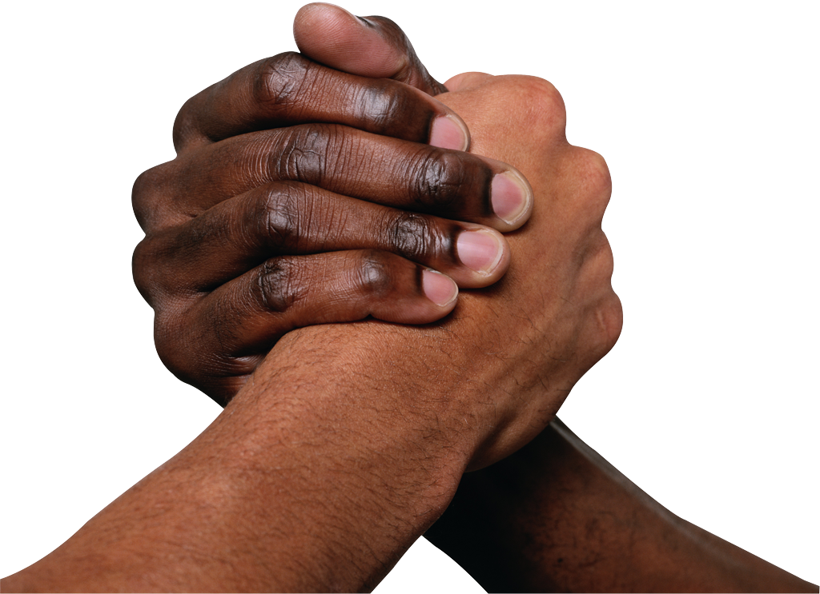
Civil Rights

Slide 29
Connecting Civil Liberties and Civil Rights… How do the 1st and 14th Amendments overlap?
The Bill of Rights Amendments originally applied to the national government
Through a case by case basis, the courts required the states to also follow most of the provisions of amendments 1-8
This process is called selective incorporation
A group facing discrimination due to expressing an unpopular or extreme viewpoint, or in a religious minority, is guaranteed equal protection under the 14th amendment
This has led to great conflicts regarding which groups deserve civil rights protection
Complementary
Controversial

Slide 30
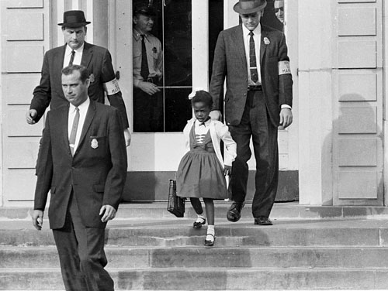
What are civil rights?
Civil rights: protections granted by the government to prevent discrimination against certain groups
Civil liberties: constitutional protections for individuals against government action

Slide 31
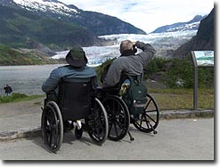
What are civil rights?
Claims are raised when a group is denied access to facilities, opportunities, or services available to other groups

Slide 32
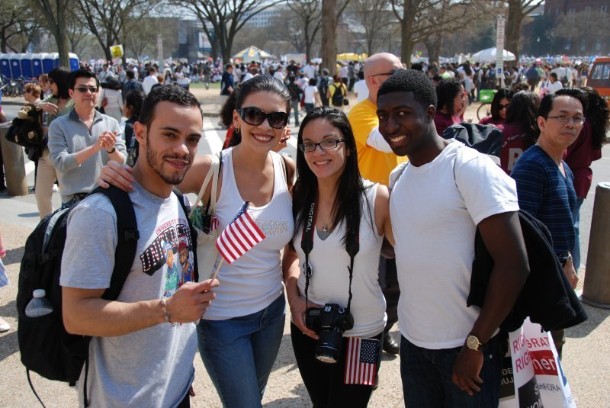
Protected Class
People protected from discrimination include ethnic minorities, women, those over 40, and disabled persons.
What do these groups have in common?

Slide 33
Separate but Equal
NAACP strategy went through a series of stages:
Step 1: 1938-48 Supreme Court ruled “for education to be equal, it must be equally available.” (Gaines and Sipuel cases)
Step 2: 1950 Supreme Court ruled “racial barriers created unequal educational opportunities.” (Sweatt and McLaurin cases)
Step 3: 1954 Supreme Court ruled that “separate educational facilities are inherently unequal.” (Brown)

Slide 34
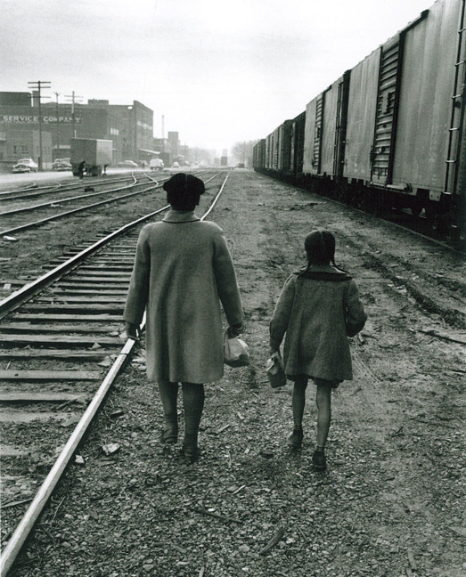
Brown v. Board of Education
Many facilities were unequal.
Other school districts, like that in Topeka, Kansas, had gone out of their way to create equally funded (yet separate) black schools.

Slide 35
Brown v. Board of Education (1954)
Unanimous Supreme Court opinion which overturned Plessy v. Ferguson (1896)
Segregation is detrimental, creating sense of inferiority in African American students
The Court relied on a psychological study of young children
Chief Justice Earl Warren sought a unanimous opinion
Violent backlash from many Southern politicians and citizens

Slide 36
Desegregation mandated by the court, yet still ignored by many
The Southern Manifesto (1954)
Non-violent civil disobedience from SCLC and SNCC
The Montgomery Bus Boycott (1955-56)
The Little Rock Nine (1957)
The Freedom Riders and sit-ins at lunch counters (1961)
“Bombing”ham, Alabama—Chief Bull Connor, German Shepherds, and fire hoses vs. the Children’s Crusade (1963)
The March on Washington (1963)
Still no widespread compliance
Leads to the “Long, Hot Summers”—periods of violent protests and rise of the Black Panthers, Malcolm X and the Nation of Islam (1964-1968)

Slide 37
What changed?
Public opinion starts to shift as television becomes common in every household
Violent segregationist reaction is now vividly portrayed
More young, college-educated people lead the shift in opinion
President Kennedy is killed (1963); worldwide shock
Midterm elections in 1964 lead to an overwhelmingly liberal majority in Congress
President LBJ gives segregationists in Congress “the Johnson treatment”

Slide 38
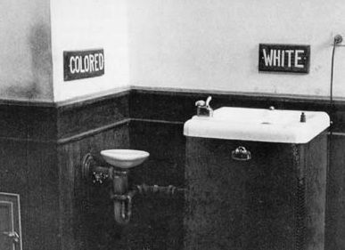
Civil Rights Act of 1964
Most comprehensive of all civil rights legislation
Prohibits discrimination in public places
schools
workplace
voting
public accommodations
Created the Equal Employment Opportunity Commission
Withheld federal grants from discriminating institutions
Authorizes suits by the US Justice Department for non-compliance

Slide 39
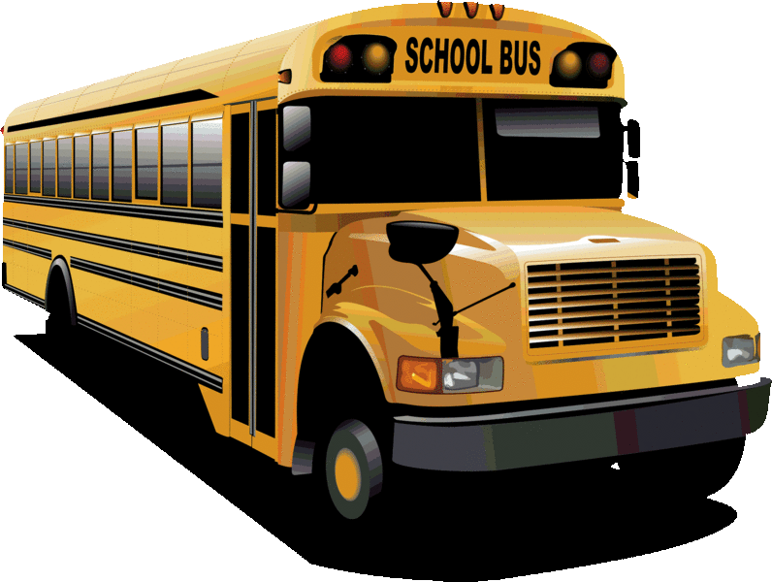
Desegregation v. Integration
Swann v. Charlotte Mecklenburg (1971): remedies may include racial quotas, redrawn district lines, and court-ordered busing
Inter-city busing could be authorized only if both the city and the suburbs had practiced segregation

Slide 40
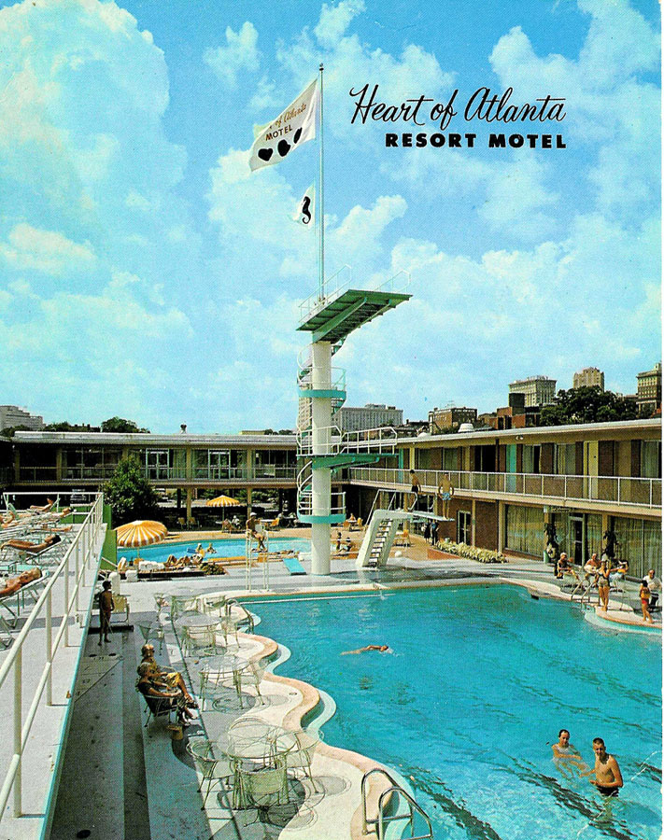
Heart of Atlanta Motel v. U.S. (1964)
A hotel owner refused to rent rooms to African Americans.
He claimed the Civil Rights Act of 1964 infringed on his rights as a private property owner.
The Court upheld Congressional authority to pass the Civil Rights Act under the Commerce Clause.
Congress has the right to regulate “interstate commerce.”

Slide 41
Gender-Based Discrimination
Arbitrary differences are not allowed.
Some gender-based differences, such as the all-male draft, are allowed by courts

Slide 42
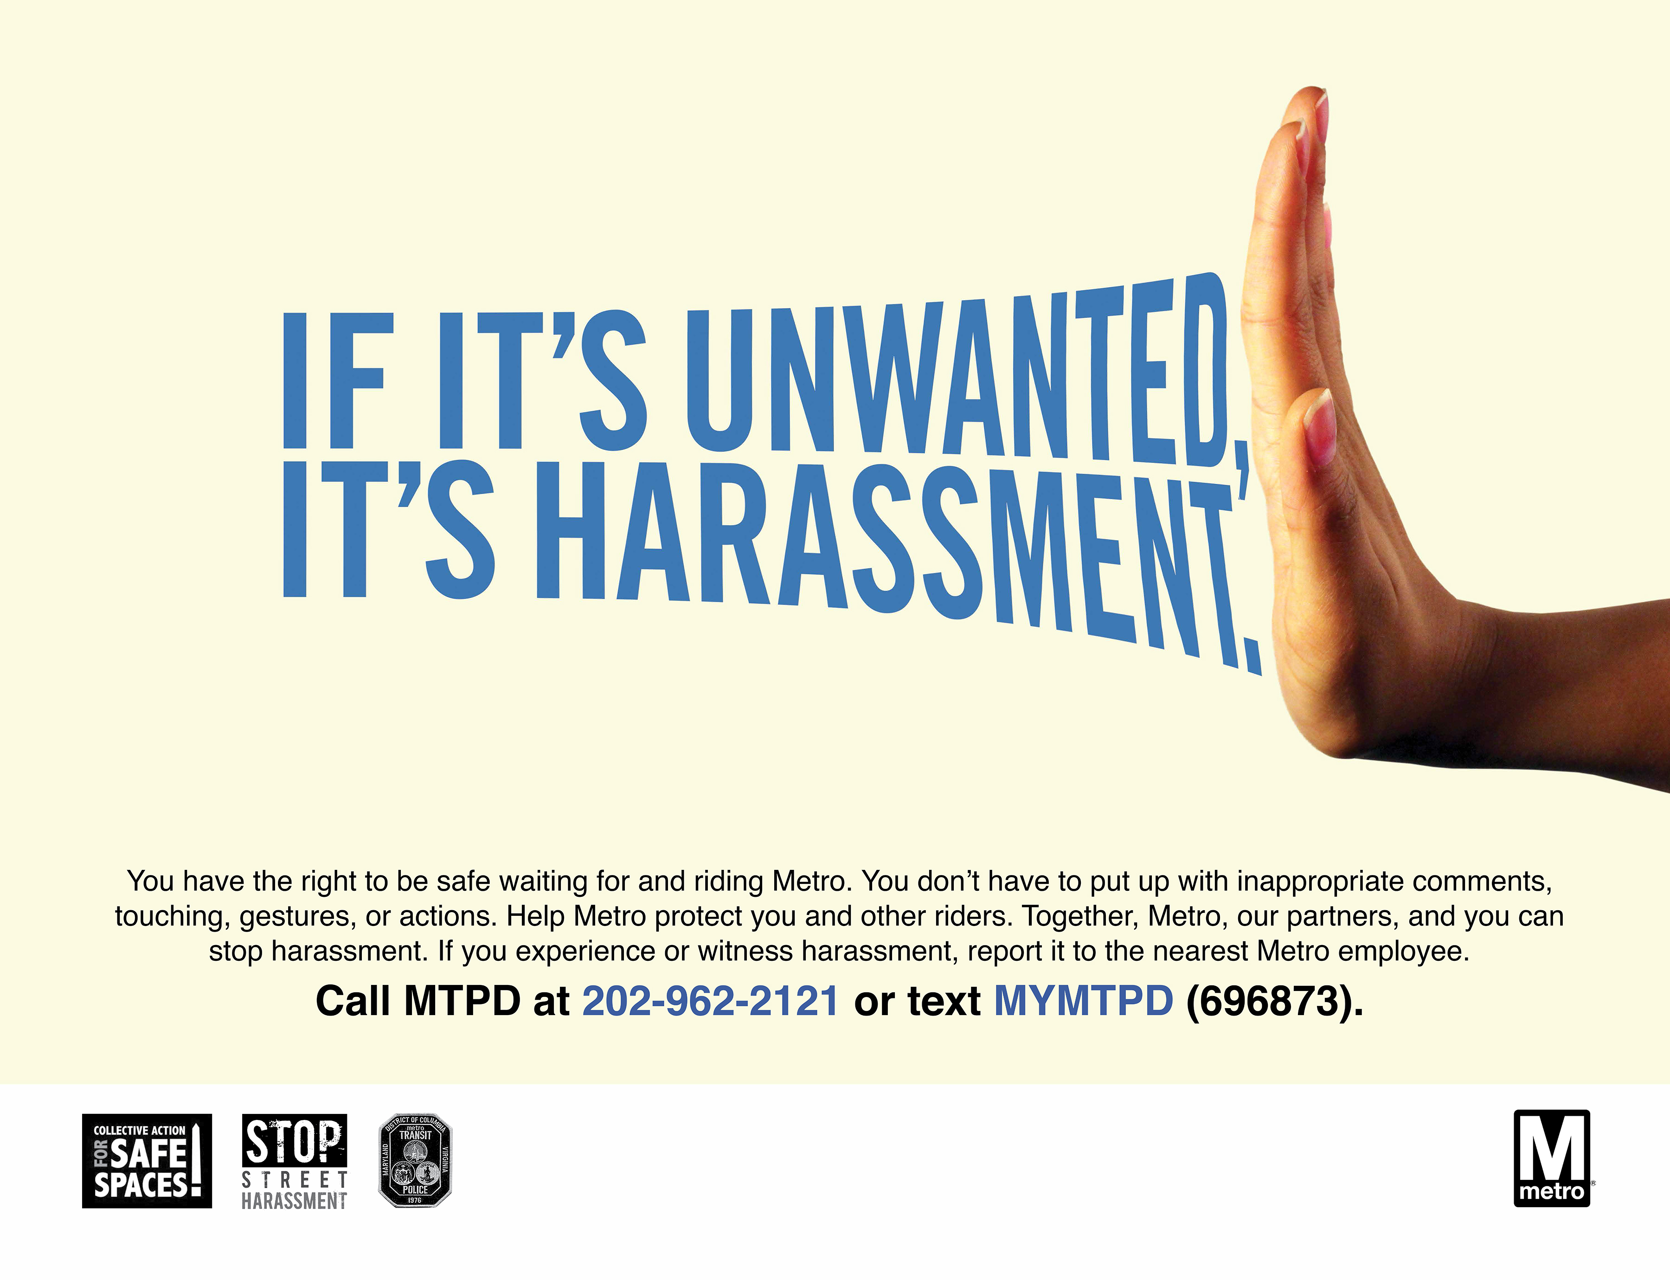
Sexual Harassment and civil rights law
Quid pro quo: sexual favors are required as a condition for holding a job or for promotion; employers are strictly liable
Hostile environment: creating a setting in which harassment impairs a person’s ability to work; employers are liable if they were negligent
Both illegal

Slide 43
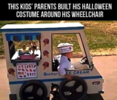
The Americans With Disabilities Act (1990)
Requires employers to make reasonable accommodations for disabled employees.
This has given rise to two issues:
What constitutes a disability?
What is meant by a reasonable accommodation?

Slide 44
Let’s take a look at some famous civil rights documents
SKIM the document assigned to your group and answer the following:
How does the document contribute or refer to
an intentional government action?
equal protection of a particular group?

Slide 45
Video Clip
Episode Three: Created Equal
(35:00 to 40:00)

Slide 46
Let’s try another Friendly Controversy
Opposite Point of View
Your group will Google a recent civil rights case
Discuss whether you agree or disagree with the Court’s decision
Then prepare a short defense of the OPPOSITE point of view from the one you agree with or support
Explain how it connects the 1st Amendment with the 14th Amendment
Only one person from the group needs to present

Slide 47
Friendly Controversy: Opposite Point of View The Cases
Obergefell v. Hodges (2015)
Snyder v. Phelps (2010)
Burwell v. Hobby Lobby Stores, Inc. (2014)
Korematsu v. United States (1944)
Loving v. Virginia (1967)
Regents of the University of California v. Bakke (1978)
Craig and Mullins v. Masterpiece Cakeshop (2014)
Shelby County v. Holder (2013)

Slide 48
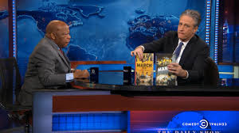
Jon Stewart interviews Congressman John Lewis
http://thedailyshow.cc.com/extended-interviews/t0qi1l/john-lewis-extended-interview

